Slide 1
Sentiment Analysis of Women's Clothing Online Reviews
Beixuan Jia, Zhenkun Wang, Qian Yi, Jingyu Zhang
Made by: InsightX

Slide 2
MOTIVATION
Nowadays, E-commerce has become one of the most important marketing channels of commercial brands. According to a Constant Contact website survey, 90% of the customers’ decisions are influenced by online reviews (Pinkham, Ryan, and Ryan Pinkham). Thus, the rating stars and recommendation levels play important roles in online sales. This project will focus on the following questions:
How to know whether a product would be recommended by other customers using sentiment analysis?
If there’s an assumption that longer text review contains more sentiment words (eg. stronger praises or stronger complains), could star ratings be predicted?
These questions are worth asking because the recommendation level and star ratings directly reflect the performance of goods, which also related to the future selling of products. If recommendation data and star ratings could be precisely predicted, the commercial brands could make better marketing strategies based on current product performance.

Slide 3
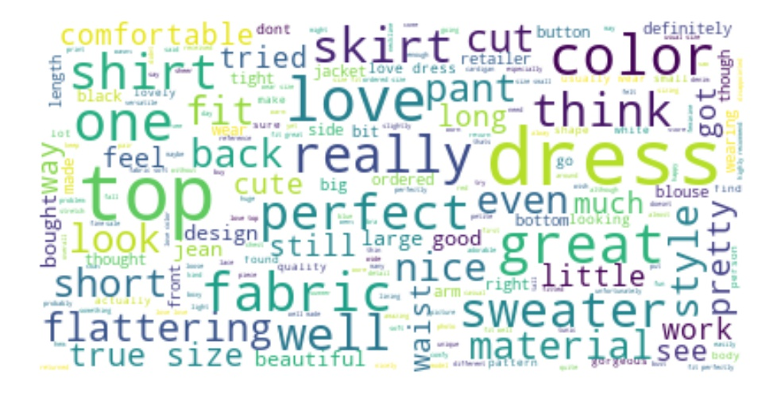
WORD CLOUD - ALL REVIEWS

Slide 4
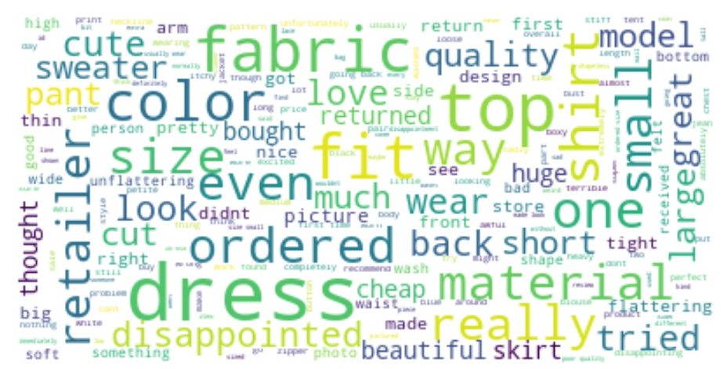
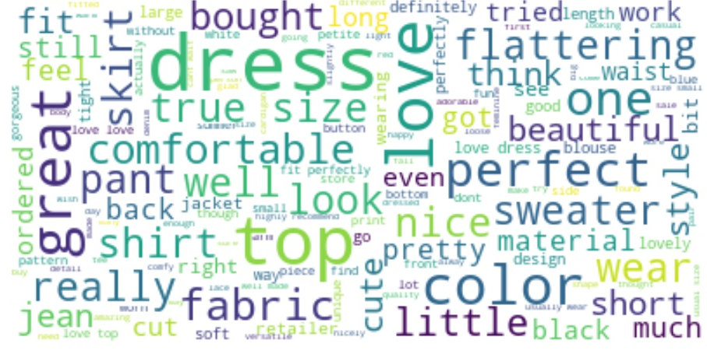
WORD CLOUD - 1 STAR VS 5 STAR
1 star
5 star

Slide 5
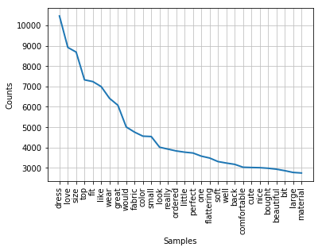
WORD Frequency

Slide 6
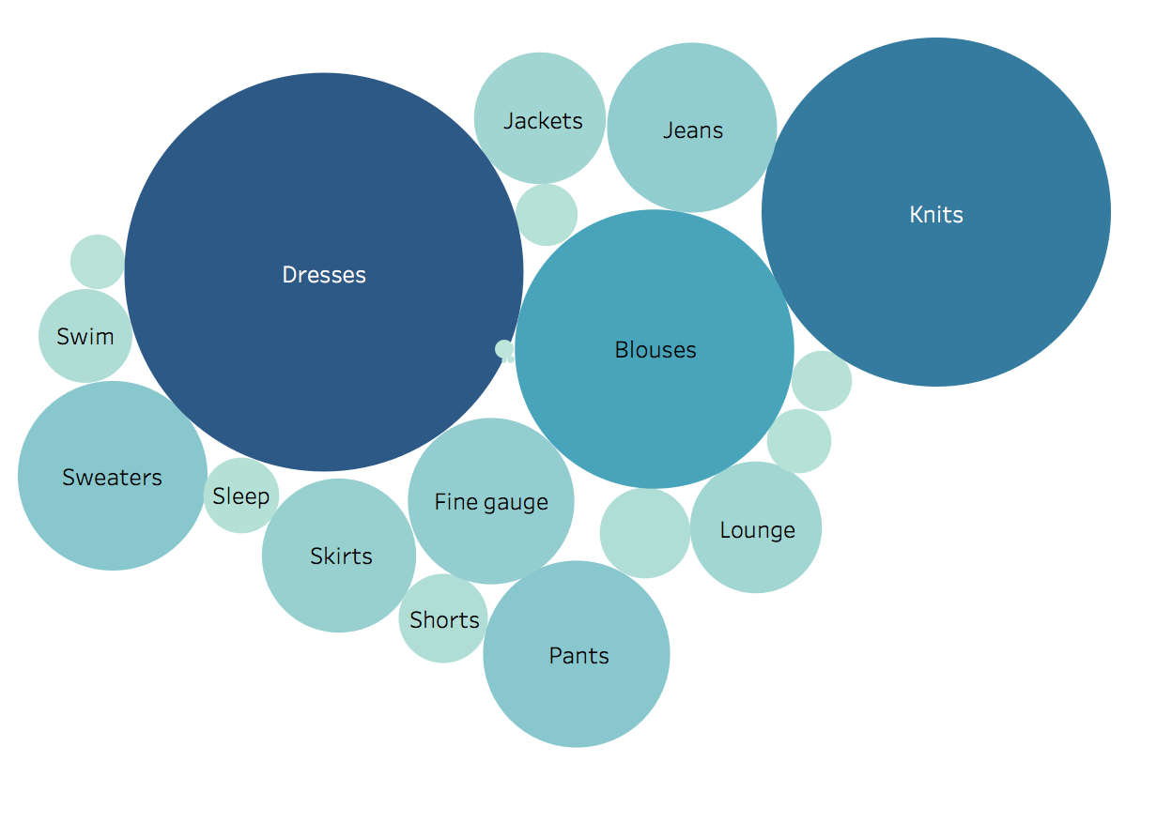
FREQUENCY REVIEW COUNT
FOR EACH CATEGORY
Notes:
Frequency ReviEW Count for each Category
Category
Color Circle Size: Number of Review

Slide 7
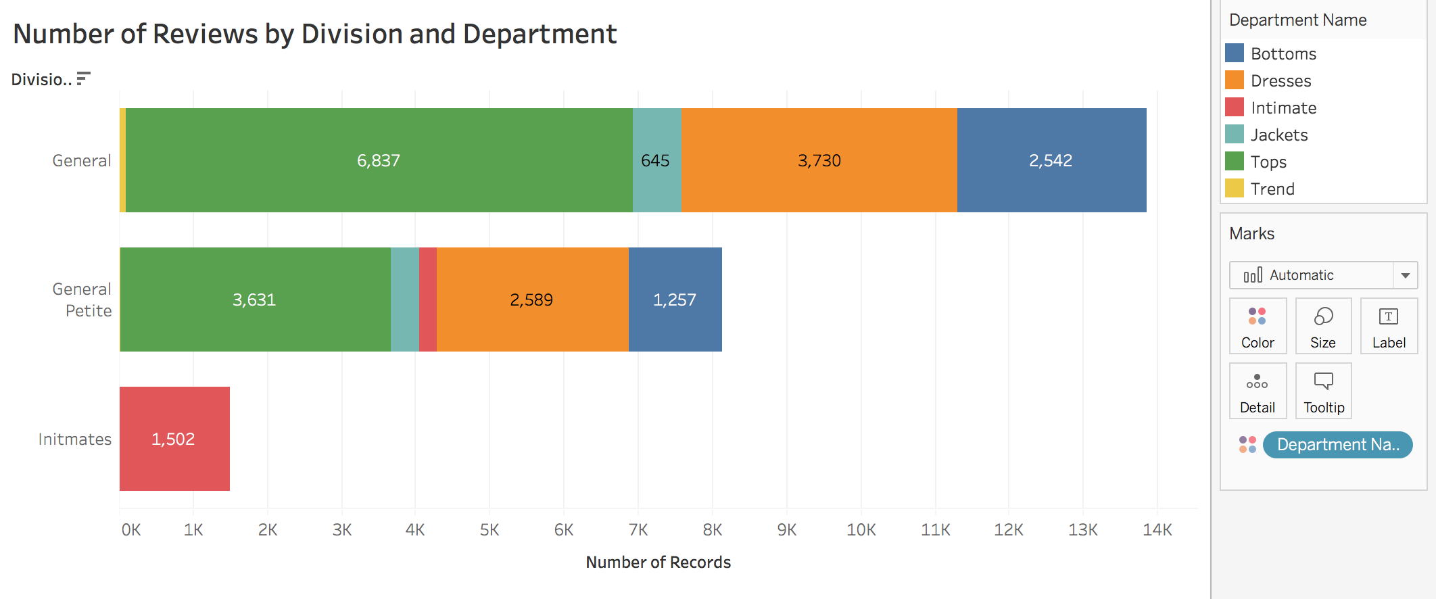
NUMBER OF REVIEWS
BY DIVISION AND DEPARTMENT

Slide 8
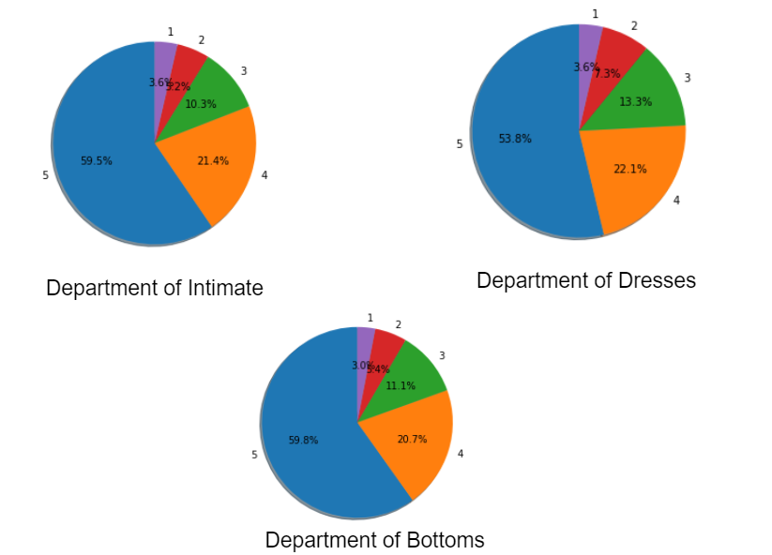
Ratings by Each Department

Slide 9
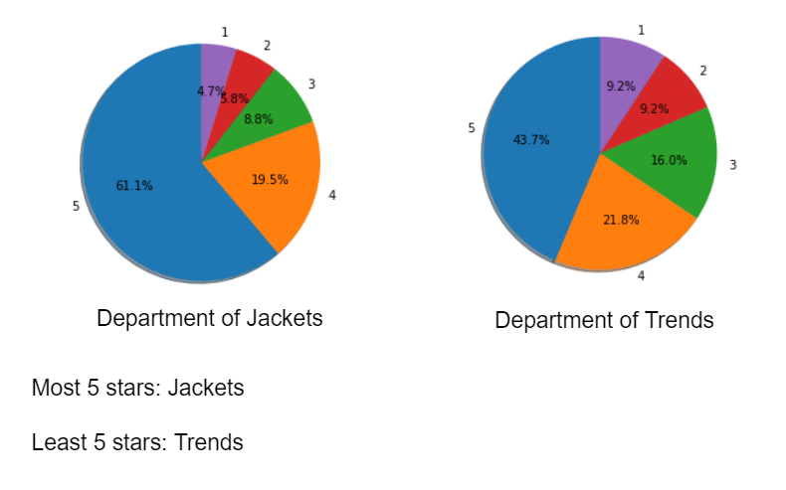
Ratings by Each Department

Slide 10
The Myth of Positive Feedback Counts (PFC)
PFC is a measurement of the amount of reviewers who found one specific comment helpful
Studying the underlying pattern of PFC would help business owners better understand the needs of customers
Hypothesis:
PFC is related to the count of words
PFC is related to the ratings

Slide 11
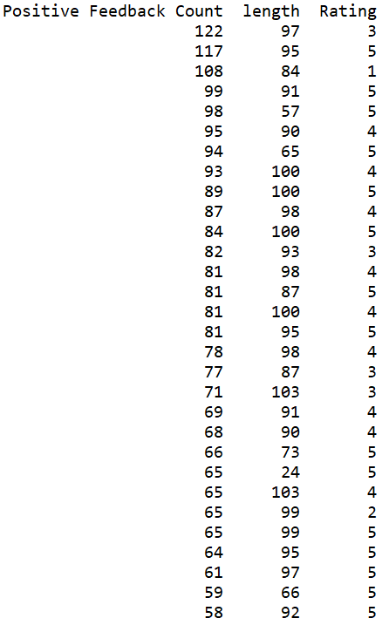
The Myth of Positive Feedback Counts (PFC)
Conclusion:
PFC is not necessarily related to the count of words
PFC is not necessarily related to the ratings - some high PFC reviews are even “neutral”
PFC is more related to the content (concise, more details)
Potential Issue: unbalanced rating distribution
Top 30 comments with the highest PFC

Slide 12
DATA
This is a Women’s Clothing E-Commerce dataset revolving around the reviews written by customers. This dataset includes 23486 rows and 10 feature variables. Each row corresponds to a customer review, and consists of the variables: Clothing ID, Age, Title, Rating, Recommended IND, etc. There are two label variables: Rating and Recommended IND. Rating is a positive ordinal Integer variable for the product score granted by the customer from 1 (worst) to 5 (best). Recommended IND is a binary variable stating where the customer recommends the product where 1 is recommended, 0 is not recommended. Therefore, by splitting the training dataset and testing dataset, NLP techniques can be used to do sentiment analysis based on the reviews and give a rating score. Additionally, NLP techniques can be applied to predict whether this customer will recommend this product to others based on the review.

Slide 13
RESULT
This is a Women’s Clothing E-Commerce dataset revolving around the reviews written by customers. This dataset includes 23486 rows and 10 feature variables. Each row corresponds to a customer review, and consists of the variables: Clothing ID, Age, Title, Rating, Recommended IND, etc. There are two label variables: Rating and Recommended IND. Rating is a positive ordinal Integer variable for the product score granted by the customer from 1 (worst) to 5 (best). Recommended IND is a binary variable stating where the customer recommends the product where 1 is recommended, 0 is not recommended. Therefore, by splitting the training dataset and testing dataset, NLP techniques can be used to do sentiment analysis based on the reviews and give a rating score. Additionally, NLP techniques can be applied to predict whether this customer will recommend this product to others based on the review.

Slide 14
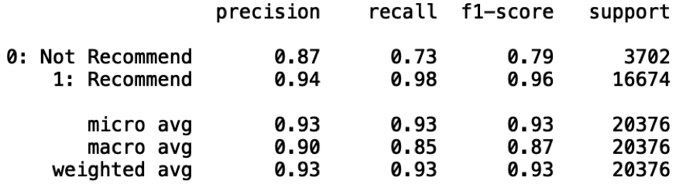
Accuracy 93%
Logistic Regression

Slide 15
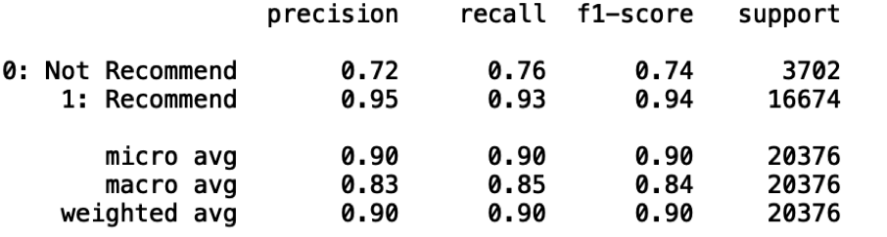
Recommend Or Not
Accuracy 90%
Multinomial Naive Bayes

Slide 16
Accuracy 93%
Logistic Regression

Slide 17
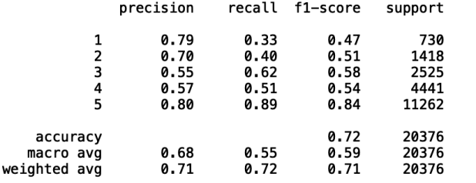
Rating
Accuracy 72%
Multinomial Naive Bayes

Slide 18
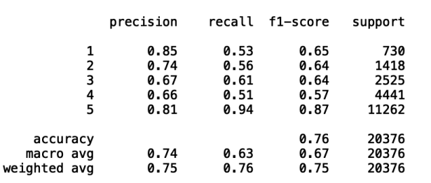
Accuracy 76%
Logistic Regression

Slide 19
